Slide 1
JAVA ☺

Slide 2
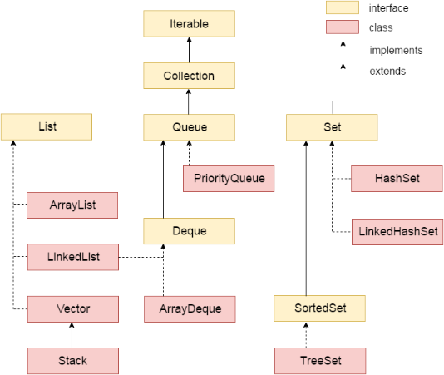
Collections
Key Concepts:
List (Interface)
ArrayList (Class)

Slide 3
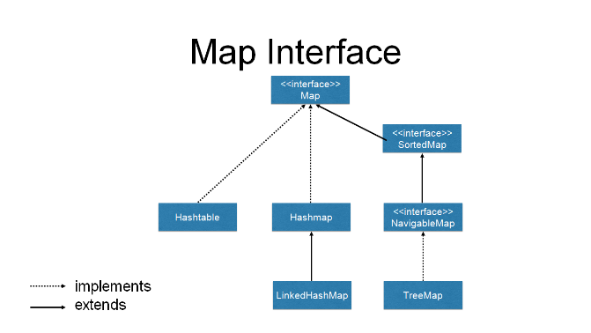
Collections
Key Concepts:
Map (Interface)
HashMap (Class)

Slide 4
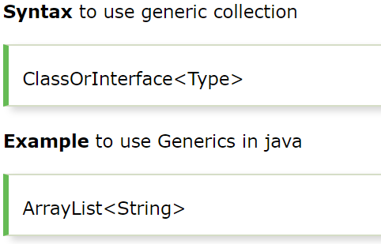
Generics
Key Concepts:
Used with Collections
Compile time checking

Slide 5
List
ArrayList class declaration
public class ArrayList<E>
extends AbstractList<E>
implements List<E>, RandomAccess, Cloneable, Serializable
Old non-generic example of creating java collection.
List al=new ArrayList();
New generic example of creating java collection.
List<String> al=new ArrayList<String>();
List<String> al=new ArrayList<>();

Slide 6
Map
HashMap class declaration
public class HashMap<E>
extends AbstractMap<K, V>
implements Map<K, V>
Old non-generic example of creating java collection.
Map m=new HashMap();
New generic example of creating java collection.
Map<String, Integer> al=new HashMap<String, Integer>();
Map<String, Integer> al=new HashMap<>();

Slide 7
¿Preguntas?

